Slide 1
Vitamins
Foreword by
Dr. Jamal Ahmed Abdul Barry
Professor
of
Clinical Biochemistry

Slide 2
Definition:
  Organic substances , essential in the diet in small amounts that are involved in fundamental functions of the body.
  OR
  A vitamin is an organic compound required as a vital nutrient in limited amounts.

Slide 3
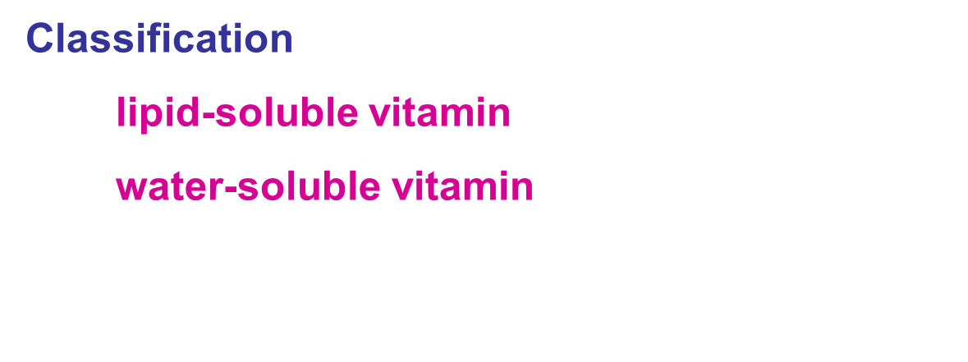

Slide 4
14 Essential Vitamins For Human Being
Vitamins
Water -soluble
Lipid-soluble
Vit C
Vit B
A, D, E, K
B1, B2, B3, B6, B12, PP, pantothenic acid，folic acid, biotin ,lipoic acid.

Slide 5
Lipid-soluble Vitamins
Common features:
  ﹡Nonpolar (hydrophobic) isoprene derivative.
  ﹡Poorly soluble in water，but good in fat and fat solvents.
  ﹡Existing with the lipids in food products and absorbing with the lipids.
  ﹡ Specifically binding to lipoprotein and certain binding-protein in blood and transportation.
  Classification:
  Vitamin A, Vitamin D, Vitamin E, Vitamin K.

Slide 6
Fat soluble vitamins include (A, K, E, and D) which are released, absorbed, and transported with the fat of diet.
They are not readily excreted in urine, and significant quantities are stored in the liver and adipose tissue.
Sometimes excess intake may lead to accumulation of toxic quantities of these vitamins.

Slide 7
Vitamin A
Chemical nature and properties
﹡Natural form：A₁（retinol）.
  A₂（3-dehydro-retinol ）.
﹡Active form ：Retinol、retinal、retinoic acid.
﹡Pro-vitamin A：β-carotene.
﹡Storage and transportation: Liver, RBP + PA and CRBP.

Slide 8
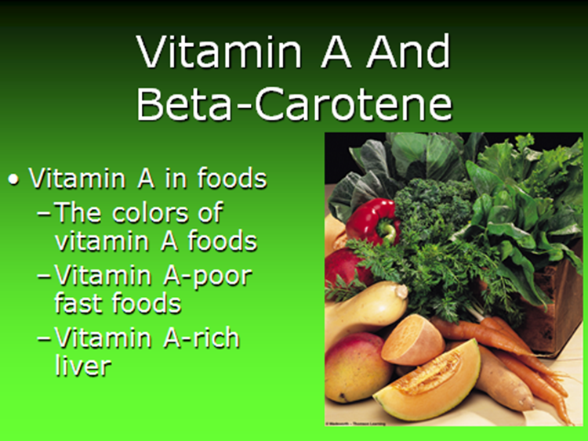

Slide 9
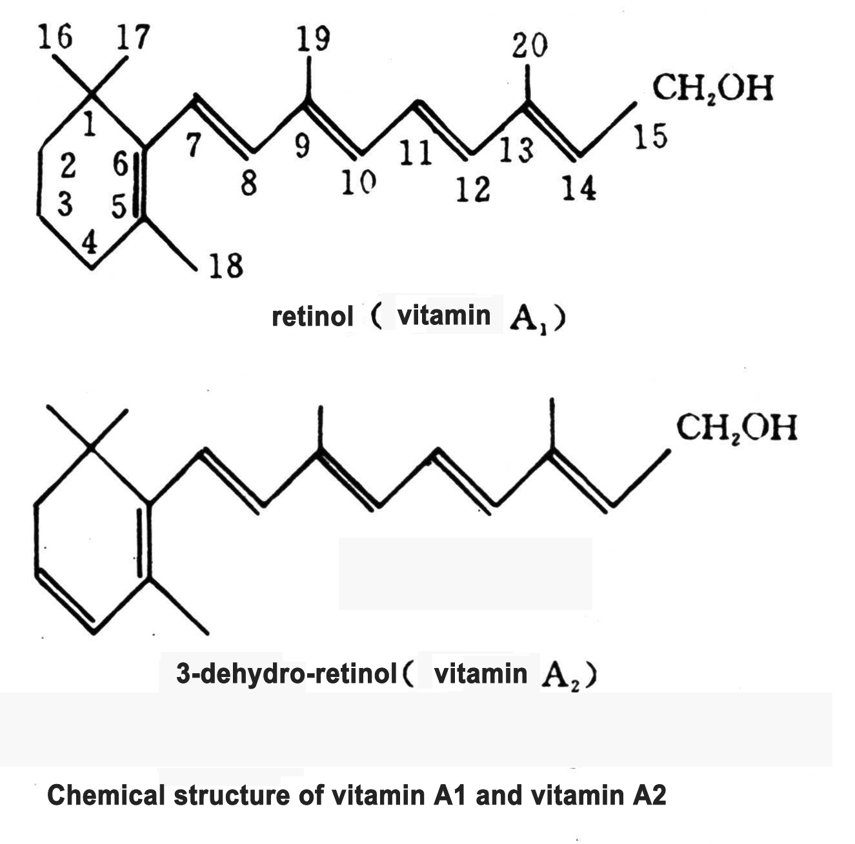

Slide 11
Biochemical function and deficiency
Biochemical function
    ＊Photographic substances in visual cell .
    ＊Participating synthesis of glycoprotein and maintaining differentiation of epithelial cells.
    ＊Other function，e.g. affecting cell differentiation.

Slide 12
Metabolism:
Retinol absorbed from the intestine is secreted as a component of chylomicrons into lymphatic system, to be taken up by, and stored in, the liver.
When needed, retinol is released from the liver and transported to extra-hepatic tissues by the plasma retinol-binding protein (RBP).
The retinol-RBP complex attaches to specific receptors on cell surface, permitting retinol to enter; then acts on nuclear receptors.

Slide 13
Functions:
Visual cycle:
Vitamin A is a component of the visual pigments of rod and cone cells. Rhodopsin, the visual pigment of the rod cells in the retina, consists of retinal specifically bound to the protein opsin.
Growth & Reproduction: Especially bone development in children.
Maintenance of epithelial cells: Vitamin A is essential for normal differentiation of epithelial tissues and mucous secretions.

Slide 14
Recommended Dietary allowance (RDA) is the level of intake of essential nutrients sufficient to meet the nutritional needs of healthy individuals in general population.
RDA: 750 μg/day
Deficiency
Night blindness, dry eyes ，dry skin, etc.

Slide 15
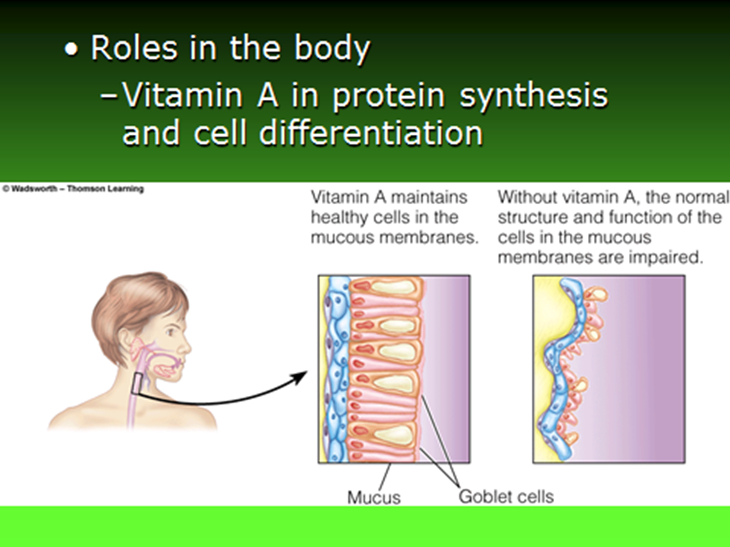

Slide 16
Synthesis and decomposition of Rhodopsin and relation to retinal
Rhodipsin
darkness
light
opsin
(retina)
11- cis retinal
All trans retinal
isomerase
Retinal reductase
isomerase
11- cis retinol
(liver)
All trans retinol

Slide 17
Light
Rhodopsin
Opsin
11-Retinal Retinal isomerase 11-trnas-Retinal
NADPH (NADH) +H+
Reduetase
NADP (NAD)
Retinol

Slide 18
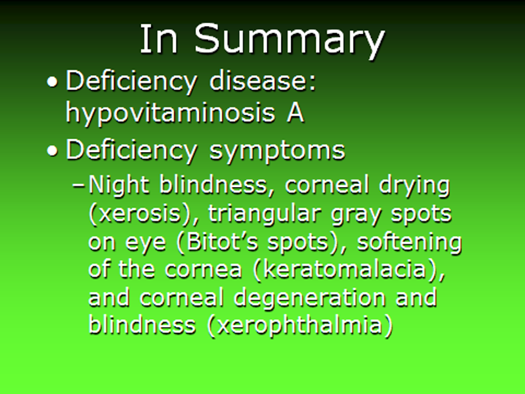

Slide 19
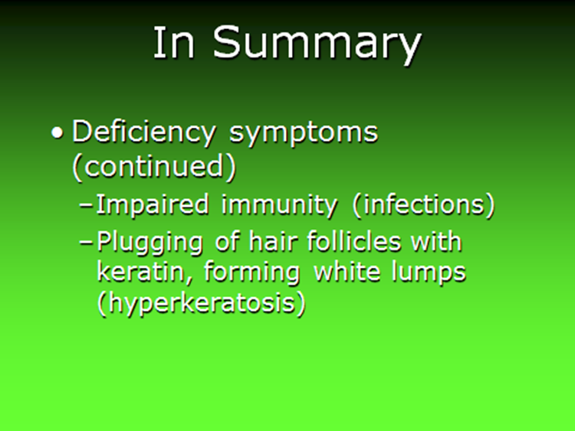

Slide 20
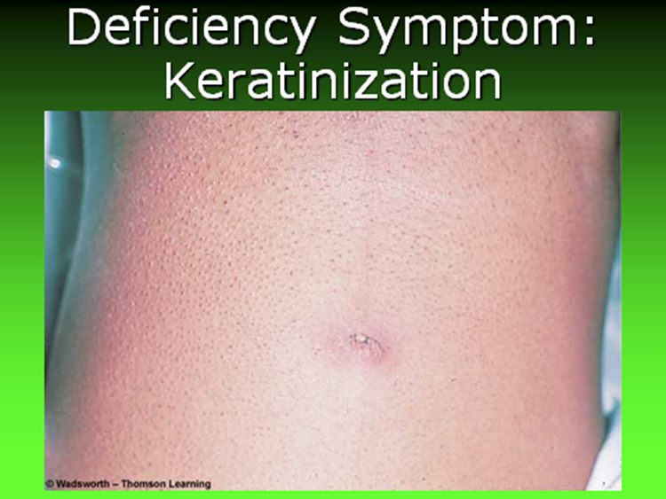

Slide 21
Vitamin D
Chemical nature and properties
﹡Types：VitD₂（Ergocalciferol）.
    VitD₃（Cholecalciferol ）.
﹡pro-VitD₂：Ergosterol
  Pro-VitD₃： 7-hydro-cholesterol
    Ergosterol → VitD_{2.}
    Cholesterol → 7-hydro cholesterol → VitD_{3.}
﹡Active form of VitD₃： 1, 25- (OH)₂-VitD_{3.}
Transportation: DBP .

Slide 22
Structure:
The D vitamins are a group of sterols that have a hormone-like function.
Two main forms are discovered:
Ergocalciferol (D2): This is obtained by irradiating the plant sterol ergosterol with UV light.
2. Cholecalciferol (D3): This is formed by irradiating the animal sterol, 7-dehydrocholesterol.

Slide 23
OH
OH

Slide 24
Conversion in the body
vitamin D₃
（Cholecalciferol）
25-OH-vitamin D₃
Liver 25-hydroxylase
（25-OH-cholecalciferol）
1α-hydroxylase in
Kidney , bone, placental
24-hydroxylase in kidney, bone , placental and cartilage.
- PTH
+ PTH
1, 25- (OH)2-VitD3 )
（1, 25-(OH)2- Cholecalciferol )
24, 25- (OH)2-VitD3
（24, 25- (OH)2- Cholecalciferol）

Slide 25
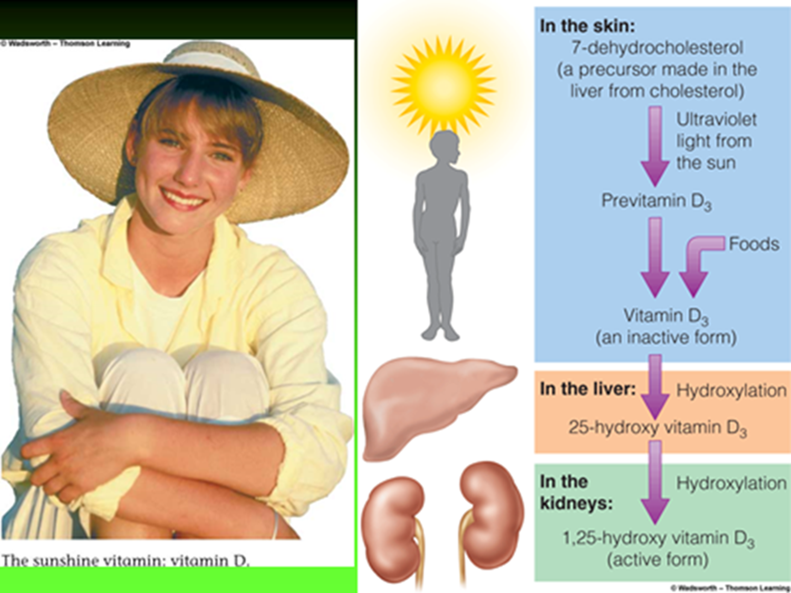

Slide 26
Sources:
Diet : D2 in plants (mushrooms) and D3 in animals (egg yolk, fortified milk, butter, liver and fish like sardines, tuna, and salmon).
Endogenous precursor: 7-dehydrocholesterol is converted to D3 in the dermis and epidermis of humans exposed to sunlight.

Slide 27
Metabolism:
Both D2 and D3 are not biologically active, but are converted in vivo to the active form of vitamin D by two sequential hydroxylation reactions:
1. Hydroxylation at 25 position is catalyzed by a specific hydroxylase in the liver resulting in 25-hydroxycholecalcoferol (25-OH-D3, calcidol) which is the predominant form in plasma and the major storage form of vitamin D.
2. Another hydroxylation at 1 position by 1-hydroxylase in the kidney, resulting in the formation of (1,25-diOH-D3, calcitriol).

Slide 28
1,25-dihydroxycolecalciferol (calcitriol) is the most potent vitamin D metabolite.
The addition of hydroxyl group by the kidney is regulated by serum calcium level, low levels accentuating the function while high levels inhibit the reaction (an example of feedback inhibition).

Slide 29
Functions:
1. Effect of vitamin D on the intestine:
It enhances calcium uptake by an increased synthesis of a specific calcium-binding protein through affecting nuclear DNA.
2. Effect of vitamin D on the kidney:
It minimizes loss of calcium through urine.
3. Effect of vitamin D on bone:
It stimulates the mobilization of calcium and phosphate from bone in a process that requires the presence of parathyroid hormone.

Slide 30
Bone is an important reservoir of calcium that can be mobilized on need to maintain plasma levels.
RDA: 200 IU which equals 5 μg/day.
The requirement of calcitriol increases in children and old age to 400 IU.

Slide 31
Biochemical function and deficiency
  Biochemical function
  Targeting on intestinal mucous、kidney and renal tubular.
  Promoting absorbance of calcium and phosphor.
  Being beneficial to formation and calcification of new bone.
  Deficiency
  Children —— Rickets.
  Adults —— Osteomalacia.

Slide 32
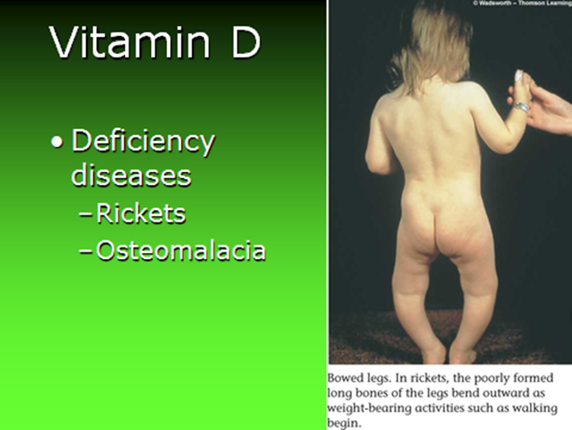

Slide 33
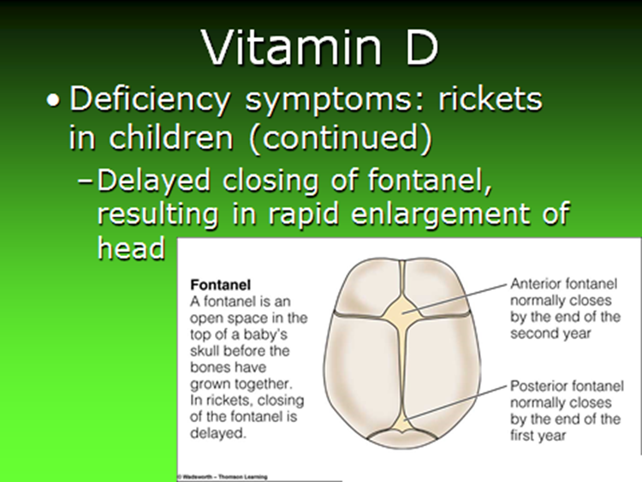

Slide 34
Vitamin E
Tocopherol
  Chemical nature and properties
  ﹡Types：Tocopherol ，Tocotrienols.
  Easy to be oxidized; protector of other substances.

Slide 36
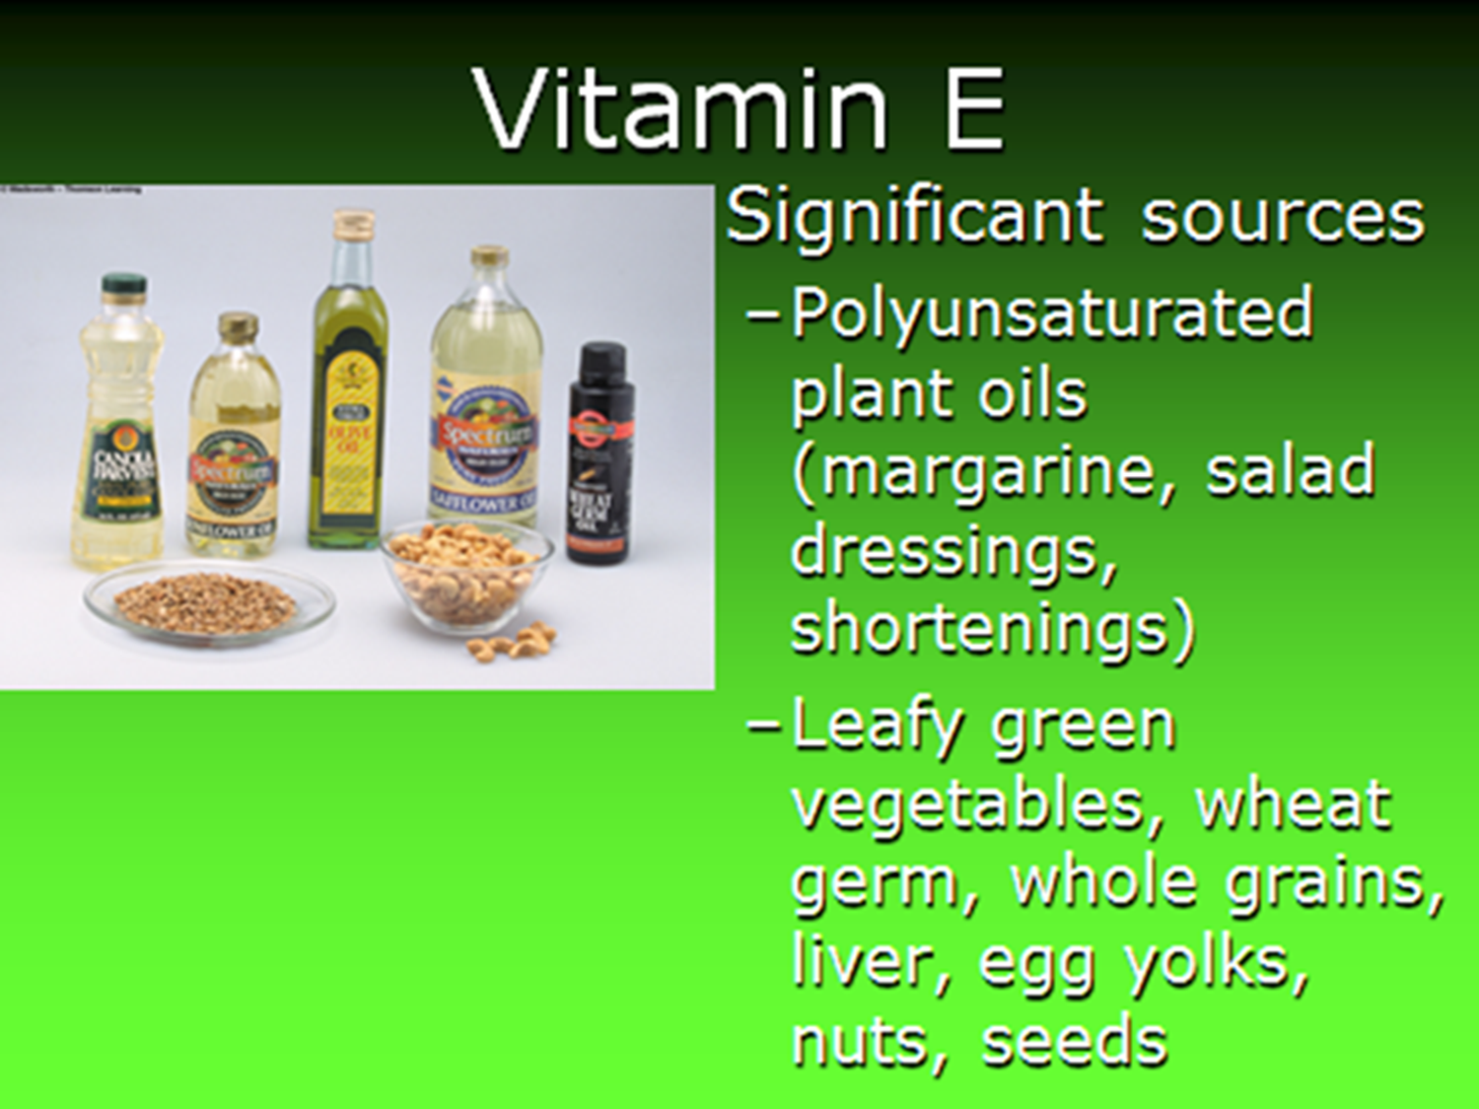

Slide 37
Structure:
α-tocopherol is the predominant isomer in plasma and the
most active form of vitamin E.
Sources: vegetable oil, fresh leafy vegetables, and egg yolk.
Metabolism:
It is readily absorbed with fats from GIT and is metabolized to unidentified substances in the tissues.

Slide 38
  Biochemical function and deficiency
  Anti-oxidation.
Vitamin E: Antioxidant
ROO· + RH → ROOH + R·
（Peroxide free radical ） （polyunsaturated fatty acids ）（organic peroxide ）（organic free radical）
R· + O₂ → ROO·
ROO·+ Vit E-OH → ROOH + Vit E-O·
  Maintaining reproduction.
  Promoting metabolism of Hb.
  (δ- amino-γ - levulinate synthase ALA).

Slide 39
Vitamin E is a powerful Antioxidant, it protects
unsaturated lipids from peroxidation.
It has a special protective role to hepatocyte and
erythrocytes' membrane's.
Numerous pharmacological action have been related to
high dose of vitamin E in humans including:-
Increase fertility.
Increase male potency.
Improvement of various skin disorders.
Relief from ischemic heart diseases.

Slide 40
Synergistic with two other essential nutrients, selenium and ascorbic acid, vitamin E is also necessary for the maintenance of normal vitamin A levels.
RDA: 15-20 mg/day.
The requirement of α-tocopherol increases as the intake
of polyunsaturated fatty acid increases.

Slide 41
Clinical correlation:
1. Deficiency:
This commonly occurs in two groups;
1. Premature; very low birth weight infants, and
2. Patients with defective lipid absorption.
Increased sensitivity of erythrocytes to peroxidation
resulting in hemolytic anemia.
2. Toxicity:
Although mega doses of vitamin E do not produce toxic effects, high doses have no proven health benefits.

Slide 42
Vitamin K
Vitamins belong to the K group are
poly-isoprenoid substituted a phthoquinones.

Slide 43
1- Vitamin K1 (phylloquinone):
Is abundant in vegetable oil, leafy green vegetable, and wheat bran.

Slide 44
2- Vitamin K2 (menaquinone):
Is synthesized by intestinal flora.

Slide 45
3- Vitamin K3 (menadione):
Is a synthetic form that exhibit the biological activity in vivo after it has been alkylated to one of the menaquinones.

Slide 46
Chemical nature and properties
Natural form：K₁、K₂( 2-methyl-1-4-naphthoquinone)
Artificial synthesis ：K₃、K_{4.}
Transportation: With lipoprotein and
Storage in the liver.

Slide 48
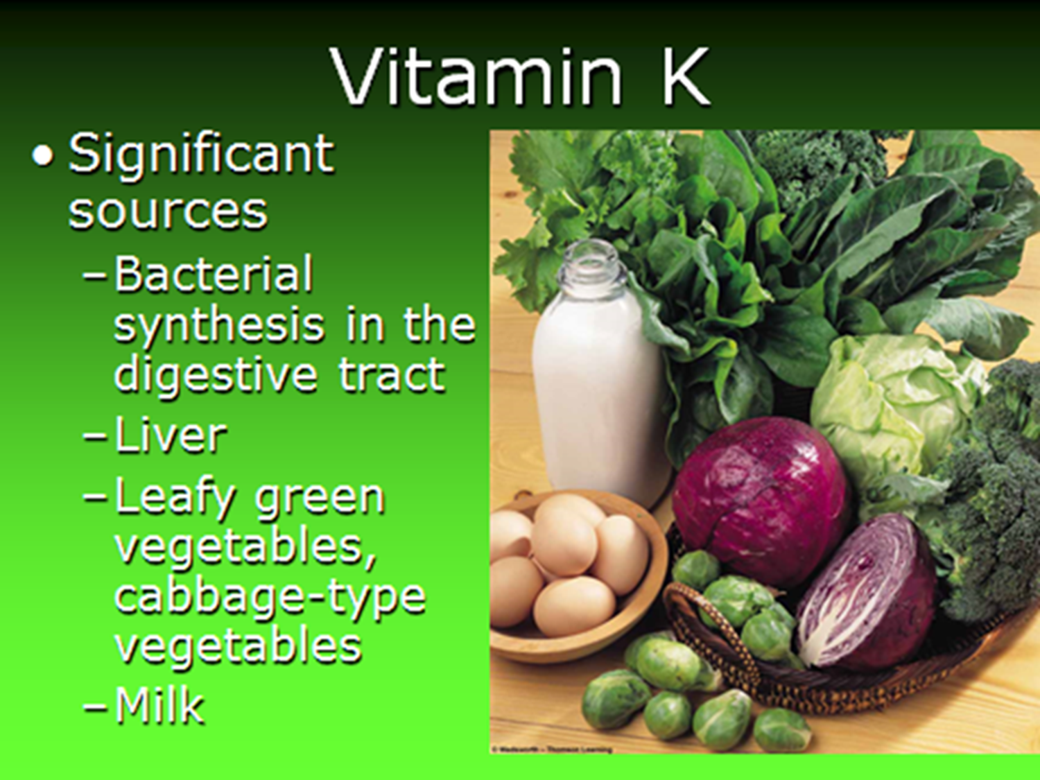

Slide 49
Biochemical function and deficiency
  Biochemical function
Maintaining the normal levels of coagulation factor
Ⅱ、Ⅶ 、 Ⅸ and Ⅹ.
Cofactor of the carboxylase:

Slide 50
Structure:
It's a derivative of pthiocol (2-methyl-3-hydroxy-1,4-napthoquinone).
Sources:
Green leafy vegetables such as spinach, cauliflower, and cabbage.
Synthesis by microorganisms inhabiting the gastrointestinal tract can provide 50% of vitamin K requirement.

Slide 51
Metabolism:
It is readily absorbed with fats in the presence of bile salts.
It is not stored to any appreciable extent.
Hence a constant supply is needed.
Functions:
The principle role of vitamin K is in the posttranslational modification of various blood clotting factors.

Slide 52
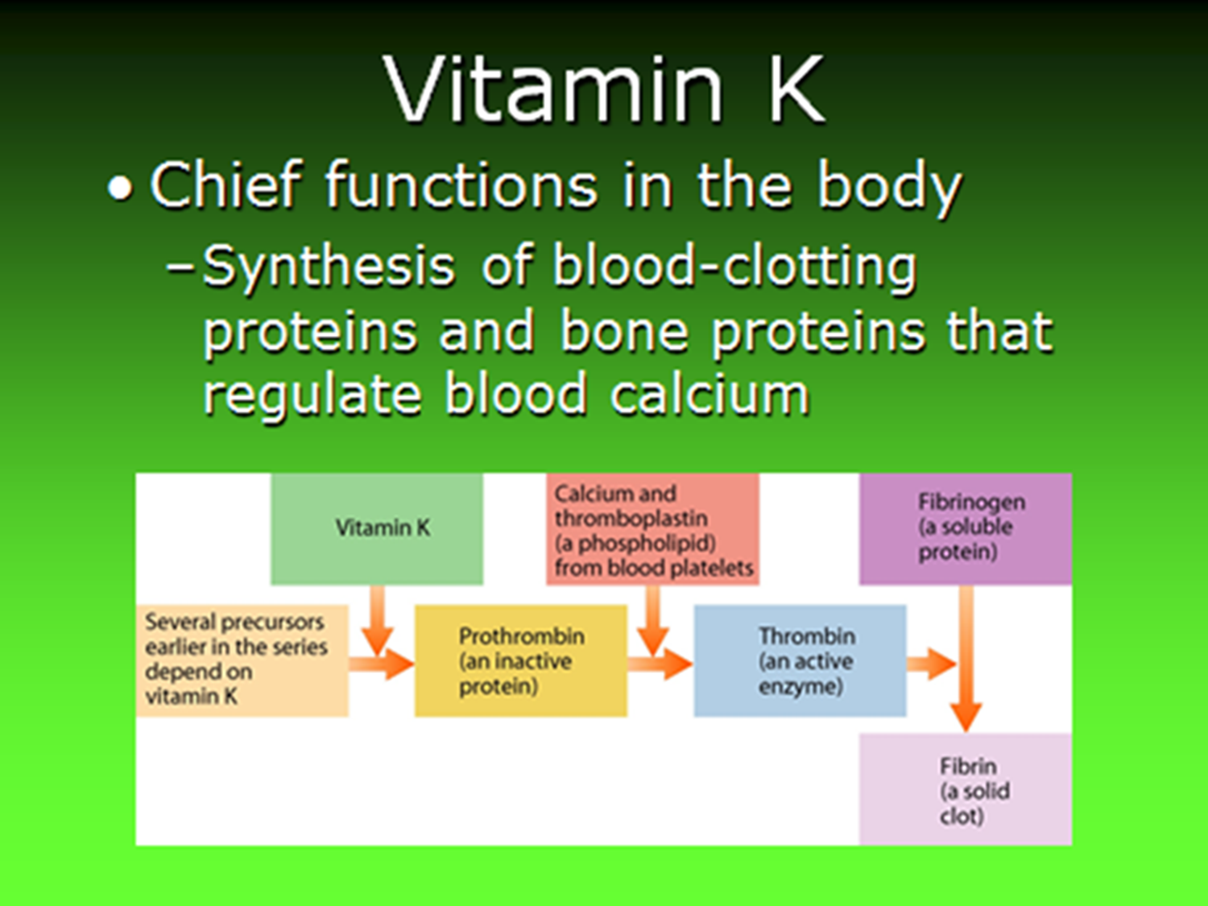

Slide 53
Hepatic synthesis of proteins II, VII, IX, and X requires the vitamin K- dependant carboxylation of glutamic acid residue (Glu) to form mature clotting factor containing γ-carboxyglutamic acid (Gla) that is capable of subsequent activation of clot formation.
The Gla residues help to chelate calcium in a protein-calcium-phospholipid interaction on the surface of platelets.
RDA: 90-120 μg/day.

Slide 54
Clinical correlations:
1. Deficiency:
It can lead to easy bruising, bleeding, and hemorrhagic disease.
A true vitamin K deficiency is unusual because adequate amounts are generally produced by intestinal bacteria or obtained from diet.
Deficiency may be caused by antibiotic therapy.
Newborns have sterile intestines and so initially lack the bacteria that synthesize vitamin K.

Slide 55
Vitamin K deficiency or the use of vitamin K-antagonists may lead to hemorrhagic episodes.
Vitamin K is not assayed but prothrombin time is used as a functional indicator of its status.
With a vitamin K deficiency, PT is prolonged .
2. Toxicity:
It is not commonly seen in adults, but large doses to infants can produce hemolytic anemia and jaundice.

Slide 56
Section Ⅱ
Water-soluble Vitamins
.
Common features:
﹡Water soluble，easy to be discharged through the urine
﹡Not easy to be stored in the body，requiring diet inception .
Classification:
  1. Vitamin B family.
  2. Vitamin C.

Slide 57
Vitamin B1
(Thiamine )
Chemical nature and properties
﹡Vitamin B₁: Thiamine.
﹡Active form :Thiamine pyrophosphate (TPP).
Thiamin is utilized for the intracellular synthesis of thiamin pyrophosphate (TPP) by the action of enzyme called thiamin diphosphotransferase.
Thiamin + ATP →→→ TPP + AMP

Slide 58
Thiamine pyrophosphate (TPP)

Slide 59
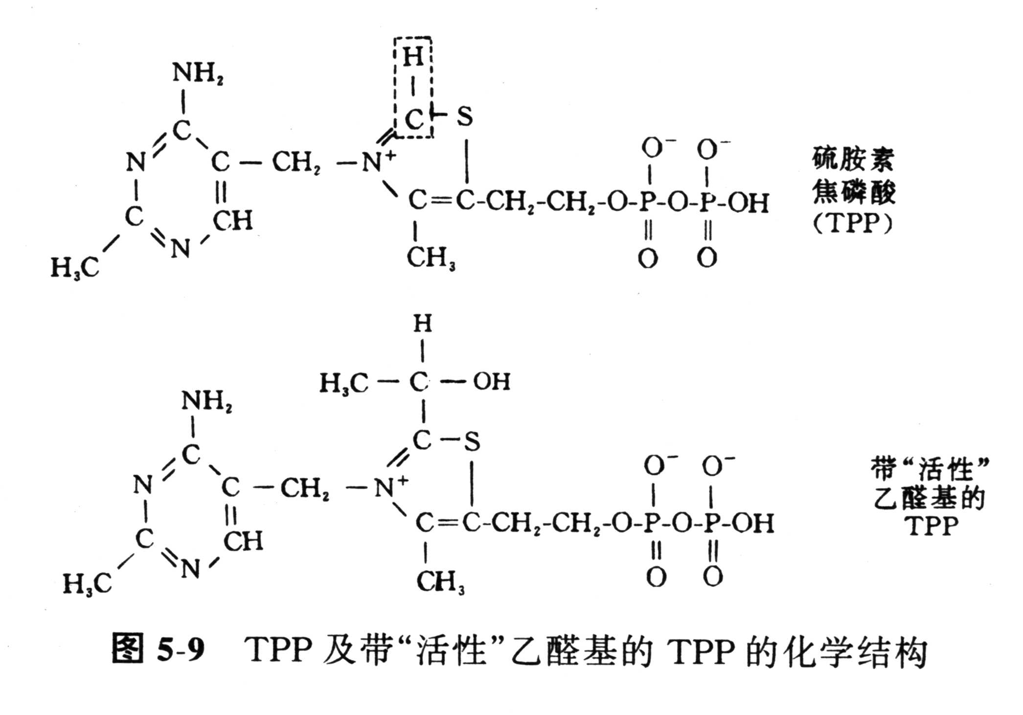

Slide 60
Thiamin:
Important in
1. Producing energy from carbohydrates.
2. Proper nerve function.
3. Stabilizing the appetite.
4. Promoting growth and good muscle tone.
5. ATP production.

Slide 61
Biochemical function and deficiency
Biochemical function
﹡TPP: Is a Co-enzyme of oxidative decarboxylation of α–keto acids examples pyruvate dehydrogenase enzyme and
- α- ketoglutarate dehydrogenase enzymes and transketolase reaction in pentose phosphate pathway.
With effects in the nerve conduction，inhibiting the cholinesterase activity.
  Deficiency
  ﹡Beriberi，peripheral Neuritis .

Slide 62
Sources of B-1
Pork.
Fish.
Liver.
Legumes.
Nuts.
Whole grain or enriched breads and cereals.

Slide 63
Recommendations
Men = 1.2 mg/day.
Women = 1.1 mg/day.

Slide 64
Deficiency
Loss of appetite.
Weakness & Feeling tired.
Insomnia.
Loss of weight.
Depression.
Heart & Gastrointestinal problems.

Slide 65

Deficiency:
Can result in three distinct syndromes
1. A chronic peripheral neuritis which may
occur alone (Dry beriberi) or
2.May be associated with heart failure and
edema (Wet beriberi).
3. Acute pernicious beriberi in which heart failure and metabolic abnormalities predominate without peripheral neuritis.

Slide 66
Vitamin B₂
(riboflavin)
  Chemical nature and properties
  ﹡Vitamin B₂: Riboflavin.
  ﹡ Active form : Mononucleotide (FMN) and
  Flavin adenine dinucleotide (FAD).

Slide 68
Ⅲ
Ⅱ
Ⅰ
Vit B₂
FMN
AMP
FAD

Slide 69
  Biochemical function and deficiency
  Biochemical function ：
  FMN and FAD are the prosthetic group of oxidoreductases with function of transmitting hydrogen .
  Deficiency：
  Cheilosis ，glossitis, scrotitis etc.

Slide 70
Sources of B-2
Large amounts in Dairy eggs and Meats.
Small amounts in leafy green vegetable.
Enriched in grains.

Slide 71
Riboflavin
Important in :
Energy production from Carbohydrate, fat, and protein metabolism.
Formation of antibodies and red blood cells.
Cell respiration.
Maintenance of good vision, skin, nails, and hair.
Alleviating eye fatigue.

Slide 72
Recommendations
Men = 1.3 mg/day.
Women = 1.0 mg/day.

Slide 73
Deficiency
Itching and burning eyes.
Cracks and sores in mouth and lips.
Bloodshot eyes.
Dermatitis.
Oily skin.
Digestive disturbances.

Slide 74
Who’s at Risk?
People with cataracts.
People with Sickle Cell Anemia.
Alcoholics.

Slide 75
Vitamin B₃
(Nicotin acid, Nicotinamid, Vitamin PP)
  Chemical nature and properties
﹡vitamin PP:
  Nicotinic acid.
  Nicotinamide.
﹡Active form
Nicotinamide adenine dinucleotide (NAD⁺)
Nicotinamide adenine dinucleotide phosphate (NADP⁺)

Slide 77
Recommendations
Men = 16 mg/day.
Women = 14 mg/day.

Slide 78
Niacin amide & Niacin
Important in
Energy production.
Maintenance of skin and tongue.
Improves circulation.
Maintenance of nervous system.
Health of the digestive track.

Slide 79
Niacin amide & Niacin
Two Types
Niacin amide (Nicotinamide)
does not regulate cholesterol.
Niacin (Nicotinic Acid)
Highly toxic in large doses.
Inositol Hexaniacinate is a supplement that gives the
cholesterol regulation without high toxicity.

Slide 80
  Biochemical function and deficiency
Biochemical function
  ﹡NAD⁺ and NADP⁺: Coenzyme of dehydrogenases（Malate dehydrogenase, lactate dehydrogenase), transfer of hydrogen 。
  Deficiency
  Cause Pellagra

Slide 81
Pellagra
Disease caused by B-3 deficiency.
Gastrointestinal disturbance, loss of appetite.
Headache, insomnia, mental depression.
Fatigue, aches, and pains.
Nervousness, irritability.

Slide 82
  Deficiency:
Result in disease called pellagra, their symptoms include :
Dermatitis, diarrhea, depression,and dementia.
The diet should be poor in both niacin and tryptophan for the disease to be occur.

Slide 83
Who’s at Risk?
Most people get plenty of B3 from their diet because it is added to white flour.
For every 60 mg of tryptophan taken, 1 mg of niacin can be generated.
This pathway requires vitamin B6 as a coenzyme.
Other condition leading to pellagra like disease include:
Drugs such as ionized.
Carcinoid tumor: Tryptophan metabolism is diverted to serotonin.
Hartnup disease: Tryptophan absorption is impaired.

Slide 84
Vitamin B₅
(pantothenic acid)
Is formed by the combination of pantoic acid and β- alanine.
Chemical nature and properties
  ﹡pantothenic acid.
  ﹡active form : CoA.
  -phosphopantetheinyl : Acyl carrier protein (ACP)
Biochemical function and deficiency
  ﹡CoA and 4-phosphopantetheinyl are coenzyme of acyl transferase ，transfer of acyl.

Slide 85
Requirement:
It appear that 5 – 10 mg fulfills the daily need.
Biochemical function:
Required for the structure of the following:
1- Coenzyme A (CoA – SH) .
2- Acyl carrier protein (ACP – SH).
The thiol group act as carrier of acyl radicals , In both CoA and ACP , In fatty acid oxidation and synthesis.

Slide 86
Vitamin B₆
(pyridine derivatives)
  Chemical nature and properties
  ﹡Vitamin B₆: Pyridoxine
  Pyridoxal
  Pyridoxamine
  ﹡Active form : Pyridoxal -Phosphate
  pyroxamine -Phosphate

Slide 88
Recommendations
Men =1.3 ----- 1.7 mg/day.
Women =1.2 --- 1.5 mg/day.

Slide 89
Biochemical function and deficiency
  Biochemical function
  ﹡Pyridoxal-Phosphate
  Coenzyme of amino acid aminotransferase, decarboxylase, and δ- amino-γ- levulinate synthase （ALA synthase）.

Slide 90
Pyridoxine
Important in:
Production of red blood cells.
Conversion of tryptophan to niacin (B-3).
Immunity.
Nervous system functions.
Reducing muscle spasms, cramps, and numbness.
Maintaining proper balance of sodium and phosphorous in the body .

Slide 91
Deficiency
Nervousness, insomnia.
Loss of muscle control, muscle weakness.
Arm and leg cramps.
Water retention.
Skin lesions.

Slide 92
Who’s at Risk?
Very rare.
Alcoholics.
Patients with kidney failure.
Women using oral contraceptives.

Slide 93
In childhood can result in poor growth, anemia, decrease immunity, and convulsion in infant.
In adult there is no characteristic syndrome for ex. may lead dermatitis and polyneuritis.
Increased sensitivity to steroid hormone action may be important in the development of hormone dependent cancer ex. breast cancer.

Slide 94
¤Nursing infant whose mother are depleted of the vitamin owing to long term use of oral contraceptive pills.
¤ Alcoholics: Ethanol metabolized to acetaldehyde which in turn stimulate the hydrolysis of the phosphate of the coenzyme.
Antituberculous drug (isoniazid) can induce B6 deficiency by forming a hydrazone with pyridoxal phosphate which excreted in urine.

Slide 95
Vitamin B 7
(Biotin)

Slide 96
生化作用
Biochemical function
Biotin:
Co-enzyme of carboxylase（pyruvate carboxylase）.
Binding to carboxyl to
Form Carboxyl biotin
Binding to ε- amino residue of lysine to form biocytin

Slide 97
Sources:
Widely distributed in natural foods.
In addition, biotin is produce by intestinal flora which may provide most or all of the required amounts.
Requirement :
In human about 150 μg / day seem to be required.

Slide 98
Biochemical function:
Biotin is a coenzyme for carboxylase enzymes and serve as
carrier of activated carboxyl group as acetylCoA
carboxylase.
Deficiency:
Rare except among people maintained for many months
on parenteral nutrition and a very small number who eat
abnormally large amount of uncooked eggs white, which
contains avidin, a protein that binds biotin and renders it
unavailable for absorption.

Slide 99
Folic acid
Chemical nature and properties
﹡Folic acid: Pteroylglutamic acid .
﹡Active form: Tetrahydrofolate (FH₄).

Slide 100
Sources:
Good sources include liver, meats, wheat, corn, and eggs.
Requirement:
The RDA is 2 mg.

Slide 101
Pteroylglutamic acid

Slide 102
FH2 reductase
FH2 reductase
FH4
Folic acid
FH2
NADPH+H⁺
NADP⁺
NADPH+H⁺
NADP⁺
5, 6, 7, 8-FH4

Slide 103
Biochemical function and deficiency
Biochemical function ：
FH4 : Co-enzyme of transferase of one carbon unit
Deficiency :
Megaloblastic anemia.
Clinical application: Antitumor drug.

Slide 104
Requirement:
RDA for adult is 400 μg. Higher amount should be ingested during growth, pregnancy, and lactation.
THFA is the carrier of activated one carbon units which may be methyl methylene, methenyl, formyl, or formimino.
The single carbon units carried by THFA utilized for nucleotide synthesis.

Slide 105
dUMP + N5.N10 – methylene THF A
Thymidate synthase
dTMP + dihydrofolice
Required in DNA synthesis

Slide 106
Deficiency:
Inadequate dietary intake
Drug ex. Methotrexate which inhibit the enzyme folate reductase.
Alcohol interfere with absorption and metabolism of folic acid.

Slide 107
Vitamin B₁₂
(cobalamin)
Has a complex ring structure called corrin ring to which is added cobalt ion at its center.
Chemical nature and properties
Vitamin B₁₂: Cobolamine.
Active form: Cobolamine and
5- deoxy adenosylcobalamin.

Slide 108
Sources:
The vitamin is synthesize exclusively by microorganisms,
thus it is absent from plant, but is conserved in animals in
the liver, where it is found as methylcobalamin,
adenosylcobalamin, and hydroxycobalamin.
Liver is therefore a good source as is yeast.
The commercial preparation is cyanocobalamin

Slide 109
Absorption:
The intestinal absorption of vitamin B12 is mediated by
receptor sites in the terminal ileum that require the vitamin
B12 to be bounded by a highly specific glycoprotein called
intrinsic factor which is secreted by gastric parietal cells.

Slide 110
Recommendations
Men and Women
= 2-3 ug/day
Biochemical function and deficiency
﹡Biochemical function:
Methyl transfer.
Deficiency :
Megaloblastic anemia , nerve disease , High blood level
of homocysteine

Slide 111
Propionyl -CoA Methyl Malonyl –CoA
Mutase
5-doexy adenosyl Cobalamine
Succinyl -CoA

Slide 112
N5-Methyl THFA Coblamine Methionine
THFA Methyl Homocysteine
Cobalamine

Slide 113
The metabolic benefit of this reaction are:
1- Synthesis of methionine from homocysteine .
2- THFA is made available to participate in nucleotide
synthesis.
Because the N5 – methyl THFA is the predominant form of
folic acid in human serum and liver.

Slide 114
A deficiency in vitamin B12 produce in its effect a deficiency
in folic acid as folate being trapped as methyl-THAF
a phenomenon called folate trap.
So in both B12 and folate deficiency there is impaired
nucleotides and DNA synthesis leading to megaloblastic
anemia.

Slide 115
There is also relative deficiency of methionine which may
account for the neurological disorder associated with
vitamin B12 deficiency (sub acute combined degeneration
of the spinal cord).

Slide 116
Cobalamin
Important in:
Proper nerve function.
Production of red blood cells.
Metabolizing fats and proteins.
Prevention of anemia.
DNA reproduction.
Energy production?

Slide 117
Deficiency
Poor dietary intake.
Vegans are at special risk.
Impaired secretion of intrinsic factor (pernicious anemia)
Gastrectomy.
Terminal ileal resection.

Slide 118
Who’s at Risk?
Pernicious anemia.
B-12 injections often taken regularly.
HIV.
Chronic Fatigue Syndrome.

Slide 119
Tissues with high degree of cell multiplication are
therefore first affected such as bone marrow leading
to Megaloblastic anaemia.
Other cells that areprone to be affected are leukocyte
and epithelial cells lining the gastrointestinal tract.

Slide 120
Vitamin C
(ascorbic acid)
Ascorbic acid is an enediol derivative of L–gulonalactone.
Chemical nature and properties
Vitamin C: Ascorbic acid.
Requirement:
Is from 30 – 50 mg.
Deficiency：Scurvy

Slide 121
Vitamin C
Dehydro-vitamin C

Slide 122
Biochemical function and deficiency
﹡Biochemical function：
1- Collagen synthesis (most important function of vitamin C).
2- Degradation of amino acid tyrosine.
3- Synthesis of epinephrine from tyrosine.
4- Bile acid formation.
5-Steroid hormones synthesis by adrenal cortex.
6-Absorption of dietary iron is significantly increase by ascorbic acid by maintain iron in the gastrointestinal tract in ferrous state. In many of these processes ascorbic acid does not participate directly but it is required to maintain a metal cofactor of the enzymes in the reduce state such as Cu⁺ and Fe^{++.}
7- Vitamin C is water soluble antioxidant.

Slide 123
Role of vitamin C in collagen synthesis:
The structure of collagen consist of three protein chains
coiled around each other to form triple helix.
The stability of collagen triple helix require the posttranslational
conversion of some of the prolyl and lysyl residues to
hydroxyprolyl and hydroxylysyl residues.
Prolyl and lysyl hydroxylases are required for the post synthetic modification of pro-collagen to collagen

Slide 124
Prolyl residue + O2 + α- Ketoglutarate
Prolyl hydroxylase
Ascorbic acid
4-hydroxy prolyl residue + Succinate

Slide 125
The enzyme prolyl hydroxylase contain ferrous ion at
its active site.
Ascorbic acid is needed as reducing agent to maintain
the iron atom in ferrous state.
Similarly some lysyl residues become hydroxylated by
the action of lysyl hydroxylase.

Slide 126
α-Lipoic acid
Oxidize type
Reduce type

Slide 127
Biochemical function and deficiency
  1. Cooperating with TPP to participate oxidative
  decarboxylation of pyruvic acid ,α–keto acid .
  2.Coenzyme of lipoic acid acetyl transferase.

Slide 128
Summary
Deficiency
Name
Form of co-enzyme
Function
vitamin B1
thiamine
co-enzyme of oxidative decarboxylation of α–keto acids and transketolase
TPP
Beriberi
Vitamin B2, rioflavin
FAD
FMN
coenzyme of flavin dehydrogenase
Cheilosis
glossitis
NAD
NADP
Coenzyme of dehydrogenase ， transfer of hydrogen
Vitamin PP
pellagra

Slide 129
Name
Form of co-enzyme
Function
Deficiency
Coenzyme of amino transferase, amino carrier amino
Vitamin B6
Pyridoxal-Phosphate
Pantothenic acid
CoA
Acetyl transfer
co-enzyme of carboxylase
carrier of CO₂
Anti biotin
protein
Biotin

Slide 130
Name
Form of coenzyme
Function
Deficiency
Folic acid
(FH4)
Carrier of one carbon unit
Megaloblastic anemia
Megaloblastic
anemia
Vitamin B12
Cobolamine- 5 –deoxyadenosyl
cobalamine
methyl transfer
Vitamin C
Ascorbic acid
（reduce）
hydroxylation
scurvy
α-Lipoic acid

Slide 131
SUMMARY
Vitamins are all organic nutrients with various essential metabolic functions, required in small amounts in the diet because they cannot be
synthesized by the body
2. Apart from vitamin C, and the water-soluble vitamins are all members of the B-complex act as enzyme cofactors
3. Thiamin is a cofactor in oxidative decarboxytion of a-keto acids and of an important enzyme the pentose phosphate pathway, transketolase

Slide 132
4. Riboflavin and niacin are each important cofactors in
oxidoreduction reactions.
Riboflavin is present as prosthetic groups in flavoprotein enzymes flavin mononucleotide and flavin adenine di nucleotide,
whereas niacin is present in the NAD and NADP cofactors of many dehydrogenase enzymes.
5. Pantothenic acid is present in coenzyme A and acyl carrier protein, which act as carriers for a groups in many important reactions,
whereas pydoxal phosphate is the coenzyme for several enzyme of amino acid metabolism including the transaminases.

Slide 133
6.Biotin is the coenzyme for several carboxylase enzymes, including acetyl-CoA carboxylase, the rate controlling enzyme in lipogenesis, and pyruvate carboxylase, important in gluconeogenesis.
7. As well as having separate functions, vitamin B12 and
folic acid take part in providing one-carbon residues for
nucleic acid synthesis.
8.Ascorbic acid is a water-soluble antioxidant that maintains
many metal cofactors in the reduced state

Slide 134
9. Absence of the water-soluble vitamins from the diet
provokes multiple deficiency states.
Absence a single vitamin leads to a characteristic deficiency
syndrome.
10.The lipid-soluble vitamin have the common features of being a polar, hydrophobic molecules and also of being isoprene derivatives.
They all require normal fat absorption to be occurring for
efficient absorption, and if this mechanism is defective,
deficiency symptoms are likely to occur.

Slide 135
11. Vitamin A (retinol) is represented not only as such in the diet but also by the provitamin (P-carotene) in plants.
Retinol and retinoic acid are con­sidered to act by controlling gene expression, whereas retinal is utilized in vision and has a role in glycoprotein synthesis.
12. Vitamin D is a steroid prohormone whose activity is carried out by its hormone derivative.
It is utilized in the regulation of calcium and phos­phate metabolism, and its omission from the diet leads to rickets and osteomalacia.

Slide 136
13. Vitamin E (tocopherol) is the most important antioxidant in the body, acting in the lipid phase of membranes throughout the cell.
It protect the effects of toxic radicals such as the peroxyl radical, mainly as a breaker of free- radical chain reactions.
14. Vitamin K is needed for the synthesis blood clotting factors (e.g, II, VII, IX, and X), as a cofactor to a carboxylase that acts mate residues of clotting factor precursor enable them to chelate calcium.
Vitamin K is the basis for their anticoagulant properties.

Slide 137


